Slide 1







Tech Trends & Demographics
Vangala Teja Siva Kumar
05/06/2024

Slide 2



OUTLINE
Executive Summary
Introduction
Methodology
Results
Visualization – Charts
Dashboard
Discussion
Findings & Implications
Conclusion
Appendix

Slide 3

EXECUTIVE SUMMARY
Tech Trends
Future Projections
Python expected to dominate
MongoDB, AWS React highly desired
Emphasis on cloud computing and JavaScript frameworks
Gender Gap
Global Distribution
Age Diversity

Slide 4

INTRODUCTION
Objective
Current Technology Usage
Future Technology Usage
Demographics
Gender distribution among developers
Respondent distribution by country and age

Slide 5

METHODOLOGY
Data Collection
Data Analysis
Visualization Creation
Story Telling
Insights
Recommendations

Slide 6
RESULTS
The analysis of the Stack Overflow Developer Survey 2019 data reveals significant insights into the current technology landscape and future trends. Python is anticipated to become the most used language, indicating its growing importance.
However, there is a gender gap in the developer community, with males dominating the field.
The survey also highlights a diverse distribution of developers across countries and age groups, with the United States, India, and Germany being the top countries represented.
These findings suggest the need for promoting diversity, advancing Python skills, and tailoring developer programs to meet the evolving needs of the community.

Slide 7
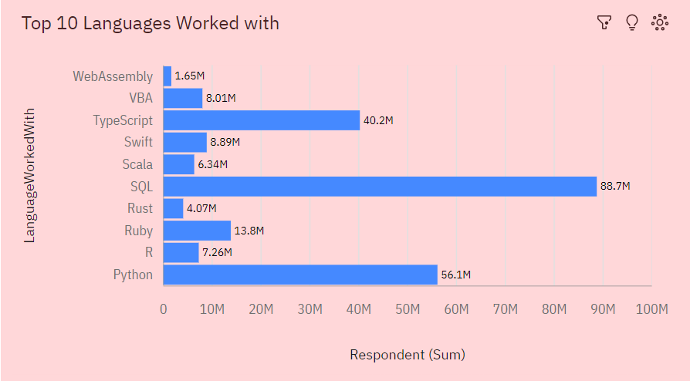
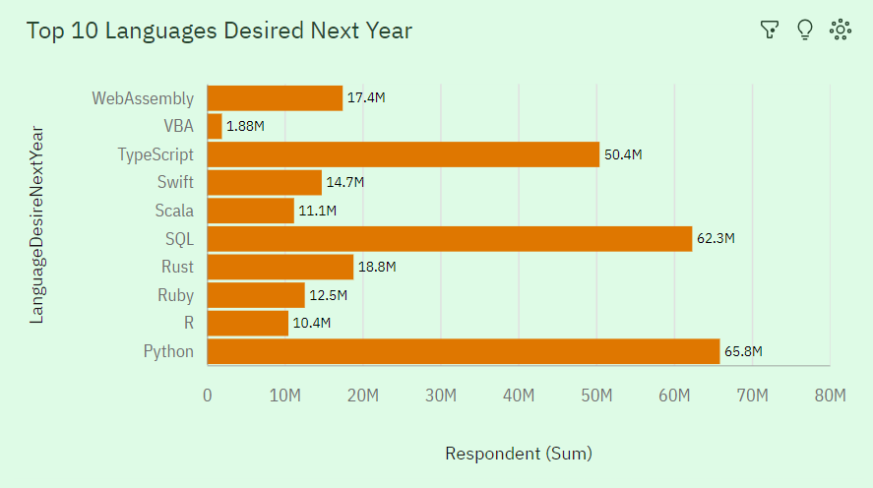
PROGRAMMING LANGUAGE TRENDS
Current Year
Next Year

Slide 8
PROGRAMMING LANGUAGE TRENDS - FINDINGS & IMPLICATIONS
Findings
Python is emerging as the future’s dominant language.
SQL is the current leader but facing projected decline.
JavaScript is enduring popularity in web development.
Implications
Prioritize Python for relevance and growth.
Diversify from SQL for future language needs.
Maintain JavaScript proficiency for web development importance.

Slide 9
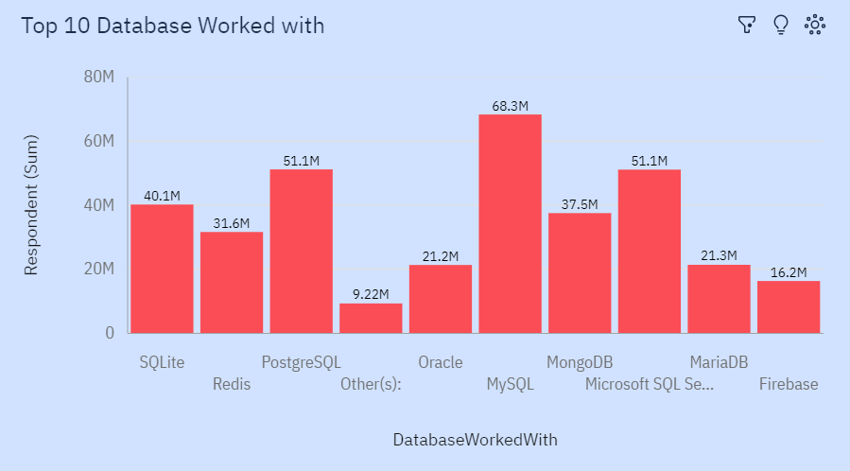
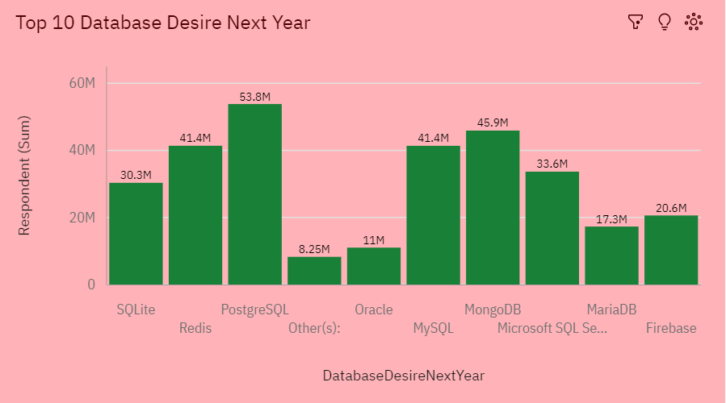
DATABASE TRENDS
Current Year
Next Year

Slide 10
DATABASE TRENDS - FINDINGS & IMPLICATIONS
Findings
MySQL maintains relevance and widespread use.
MongoDB indicates increasing interest in NoSQL databases.
PostgreSQL is popular but faces potential decline in future preference.
Implications
Diversify databases for future trends.
Evaluate and integrate MongoDB for scalability.
Monitor PostgreSQL for declining popularity.

Slide 11

DASHBOARD
https://github.com/vtejasivakumar/tejasivakumar/blob/main/Capstone%20Project1.pdf

Slide 12
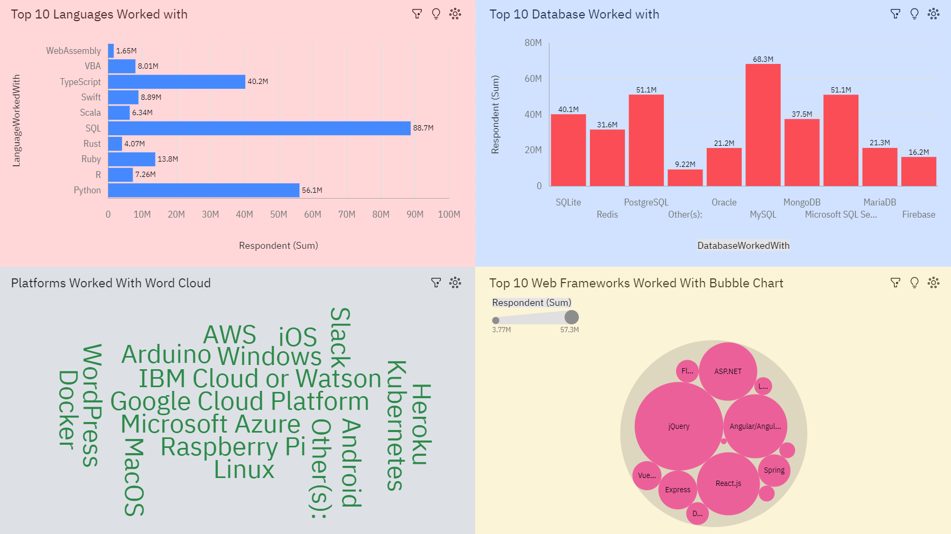
Currency Technology Usage

Slide 13
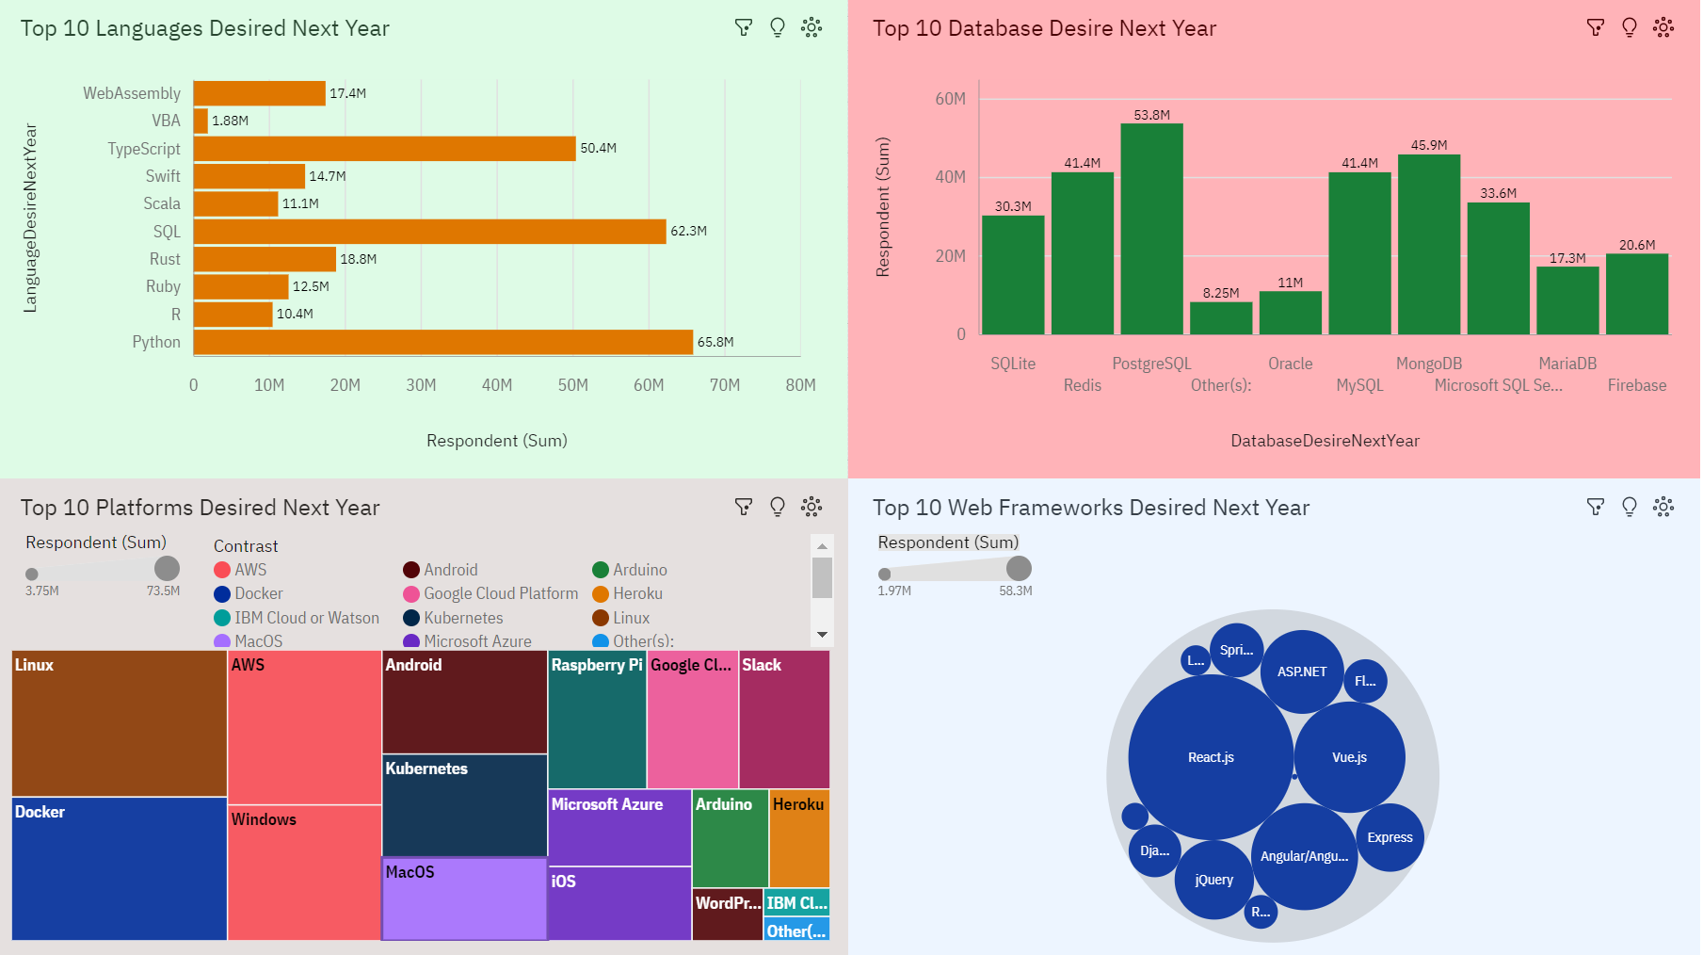
Future Technology Trend

Slide 14
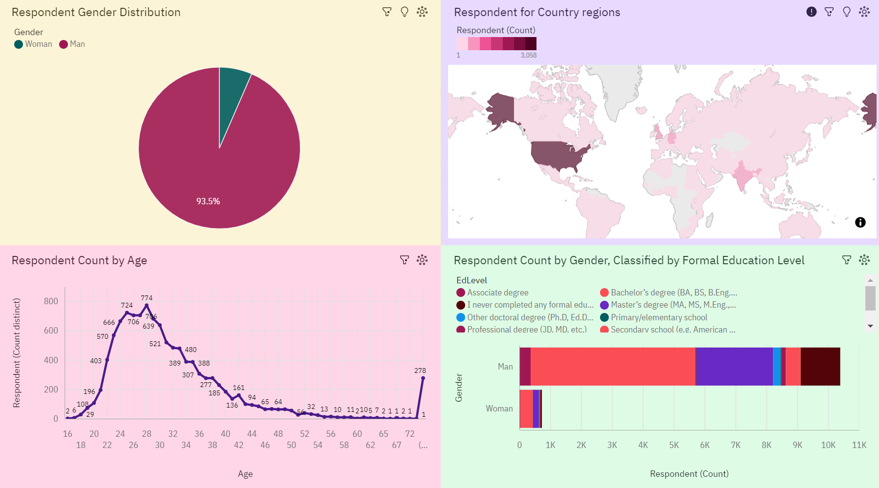
Demographics

Slide 15
DISCUSSION
Technology Adoption Strategies
Gender Diversity in Tech
Educational Initiatives
Database Selection
Programming Language Choices

Slide 16
OVERALL FINDINGS & IMPLICATIONS
Findings
Python rising, SQL waning, JavaScript enduring in web dev.
MySQL relevant; MongoDB desired; PostgreSQL may decline.
Windows, Linux, Docker common; no future trends, data focuses on current.
React, Angular, and Vue.js popular; no future trends; data focuses on current usage.
Implications
Prioritize Python; diversify from SQL; maintain JavaScript proficiency.
Integrate MongoDB for flexibility; monitor PostgreSQL trends.
Monitor platform trends; consider compatibility; stay updated for enhanced development.
Stay updated; choose based on needs; invest in proficiency.

Slide 17

CONCLUSION
Prioritize Python for its future dominance.
Integrate MongoDB for scalable, flexible NoSQL solutions.
Flexibility in platform choices is crucial.
Proficiency in web frameworks is essential for competitiveness.

Slide 18

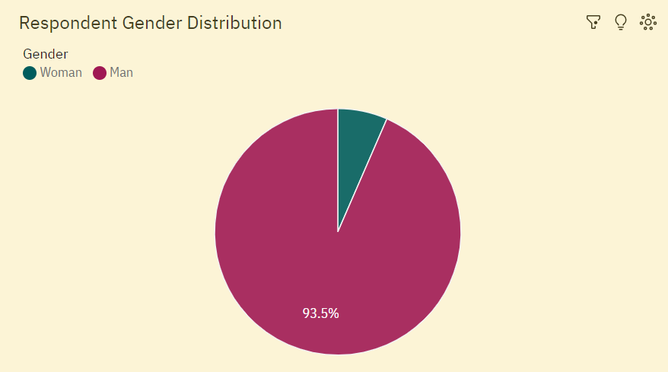
APPENDIX

Slide 19
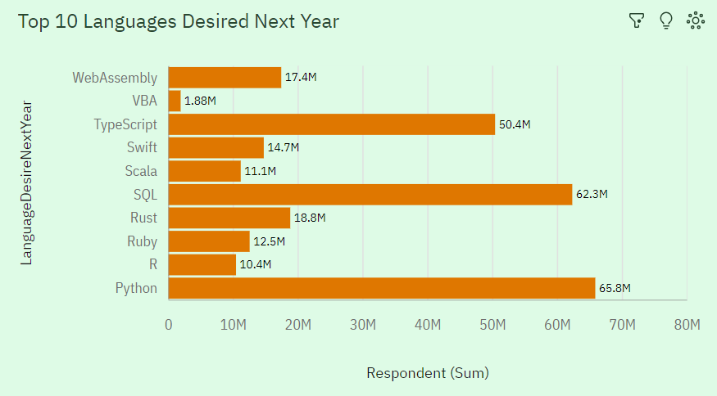
JOB POSTINGS

Slide 20

POPULAR LANGUAGES

